Slide 1
Housing Cost Prediction for India (Micro Project #1)
Amanda Lovell
October 2, 2022

Slide 2
Problem Statement
Background- The housing rental data set for India will be used to analyze which aspects or features of a home have the largest impact how much a home is rented for.
Objective-
What features affect rent prices in India?
Which are the least expensive homes?

Slide 3
Hypothesis Formulation
H0- the feature of size, number of bedrooms, and bathrooms have no effect on rental price
HA- The feature of size, number of bedrooms, and bathrooms do affect the rental price
The null hypothesis (H0) states that the feature of size, number of bedrooms, and bathrooms (independent variables) have no association to rental price (dependent variable)
The alternative hypothesis (HA) states that the features do affect rental price

Slide 4
Hierarchy Chart
HOUSING PRICE= house rental dataset(size, bedroom, bathroom)
Main program (Output: Price; Input: Housing rental price data set)

Slide 5
Flowchart
Start
Clean Data
Visualize
Preliminary Analysis
Load Data
Identify the dataset, features, statistically describe the data
Plot each feature against the desired output variable (price) to understand the nature of the data
Handle any missing data
Step 1: Acquire
Step 2: Prepare

Slide 6
Pseudocode
# Start
# Step 1: Acquire
# Import libraries
Import pandas
Import numpy
#Read dataset
dataset= pd.read_csv("C:/Users/amand/OneDrive/Data Science/ANA500/Housing.zip", compression= 'zip’)

Slide 7
Pseudocode, cont.
# Step 2 Prepare
#Nature of data
Data.head # View column headers
Data.shape # Shape of dataset (matrix dimensions)
# Search for NaN elements
Data.isnull
#Summary Stats
Data.describe()

Slide 8
Pseudocode, cont.
# Visualization
# To plot each feature against price, get the features names from the data frame features= data.columns # output is the feature name only, no data
Seaborn.scatterplot(data, x= features, y= price)
End program

Slide 9
Acquire
Housing rent data set was obtained through Kaggle.com it is a site where data scientist, machine learner practitioners, and engineers post projects, obtain open source data sets and have data science competitions.
Data Source
House Rent Prediction Dataset | Kaggle

Slide 10
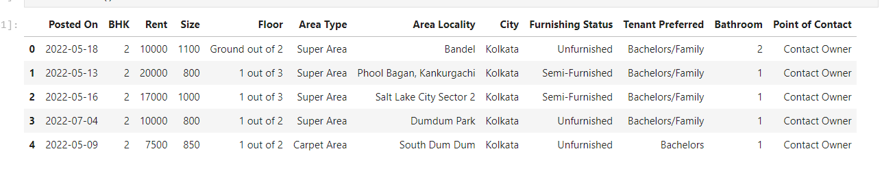
Prepare
Data.head() fuction output the column headers and the first 5 rows of the dataset

Slide 11
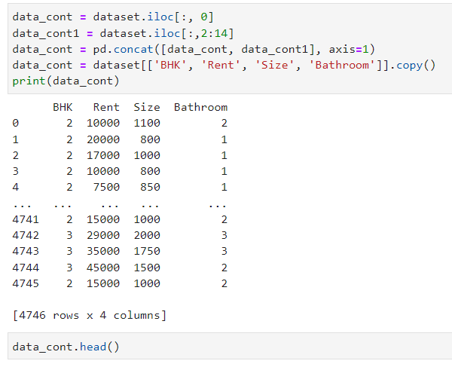
Prepare cont.
Prepare

Slide 12
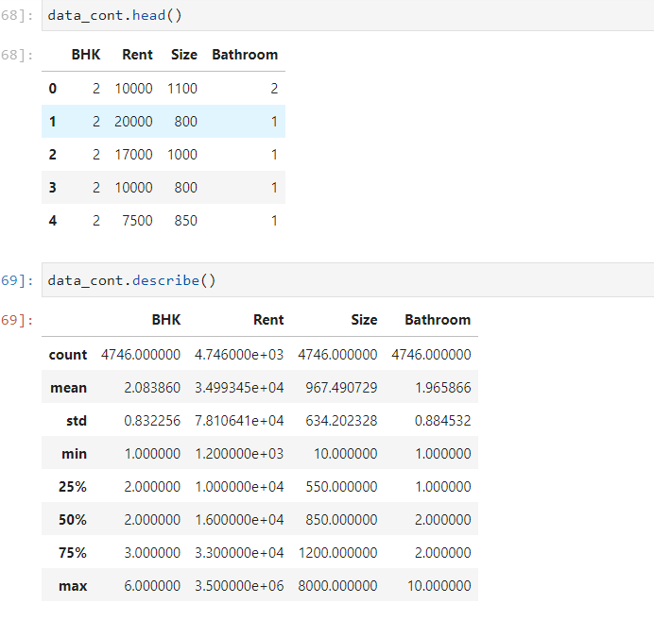
Summary Statistics

